Slide 1




Q1 PENETRATION RETEST

Slide 2





Team 4
OUR Team
Team Lead/Captain
Member/Analyst
Member/Analyst
Member/Analyst
Member/Analyst
Member/Analyst

Slide 3

Team 4
Agenda
Methodology
Engagement Highlights
Business Impact
Key Strenghts
Recommendation

Slide 4






Team 4
Assessment Methodology
Severity
Degree Of Exposure
Ease of Exploitation
Assessing the vulnerability based on impact and potential risk
Focusing on who and how someone would have access to that vulnerability
Focusing on how many steps it takes to put the normal user at risk
Focuses on how and what it takes to fix the weakness
Focuses on how that vulnerability would impact business process and operations
Effort To Fix
Business Impact

Slide 5


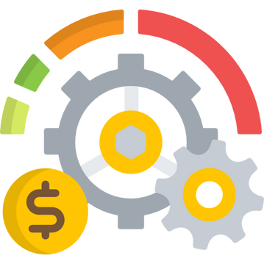
Team 4
Assessment Scope
Simulation
Development
Production

Slide 6
Team 4
Highlights
Hosts Vulnerable - 5
Catastrophical Risks
Remediated Vulnerabilities - 9

Slide 7

Team 4
Business Impact
Reputation Loss

Slide 8

Team 4
Business Impact
Remediated vulnerabilities

Slide 9

Team 4
Business Impact
Financial Loss

Slide 10

Team 4
Key Stengths
Robust Data Leakage Monitoring

Slide 11

Team 4
Key Stengths
Patching

Slide 12

Team 4
Key Stengths
Support

Slide 13
Team 4
Weaknesses
Limited Endpoint Threat Detection and Response
High Risk of Data Leakage and Data Exposure Due to weak passwords
Inadequate Network Security
Reactive Security Posture Instead of Proactive Defense
Lack of Defense in Depth Strategy

Slide 14
Team 4
Recommendation
Strengthen Web Application Security Controls
Enhance Endpoint Threat Detection and Response
Implement AI Driven Data Loss Prevention Controls
Establish Robust Network Security

Slide 15
Team 4
Conclusion
Growth Opportunity
Enhance Security
Reduce Business Risk

Slide 16
Team 4
Q&A

